Slide 1
Measures of Central Tendency
PSYC 2020J Tutorial 3

Slide 2
Measures of Central Tendency
Mean
Can be used on interval & ratio
Median
Can be used on interval, ratio, ordinal
Why not nominal?
Mode
Can be used on interval, ratio, ordinal, nominal
Less common for the continuous data (interval & ratio)

Slide 3
Frequency Distribution
Ungrouped
Frequencies represent each individual score
x | Frequency (f)
1 | 2
2 | 5
3 | 3
4 | 4
5 | 2
x | Frequency (f)
1-2 | 2
3-4 | 5
5-6 | 3
7-8 | 4
9-10 | 2
Grouped
Frequencies represent a class/interval of scores

Slide 4
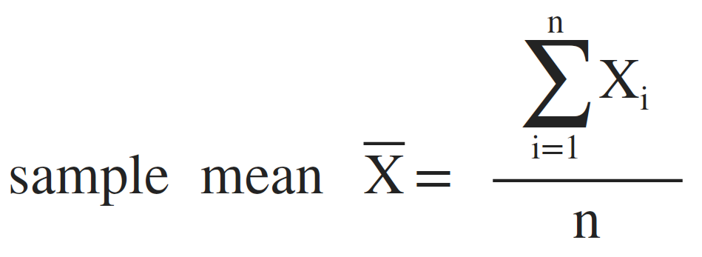
Mean
The sum of the scores divided by the number of the scores

Slide 5
Mean for a Population vs a Sample
Recall, when we use statistics, we are often using a sample to make inferences about a population
Different symbols to distinguish samples for a population
∑𝑁 _{𝑋}
1 i
𝑁
𝝁 =
Difference?

Slide 6
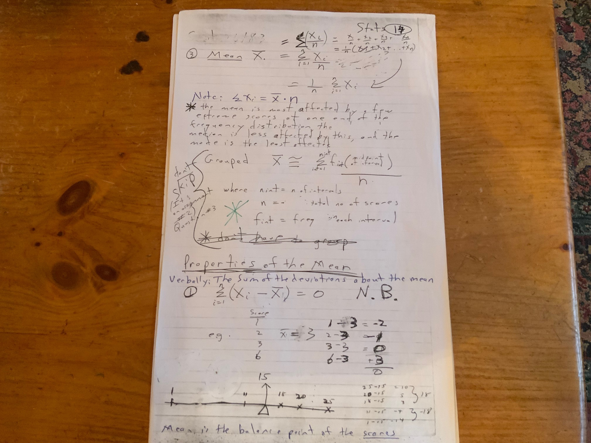
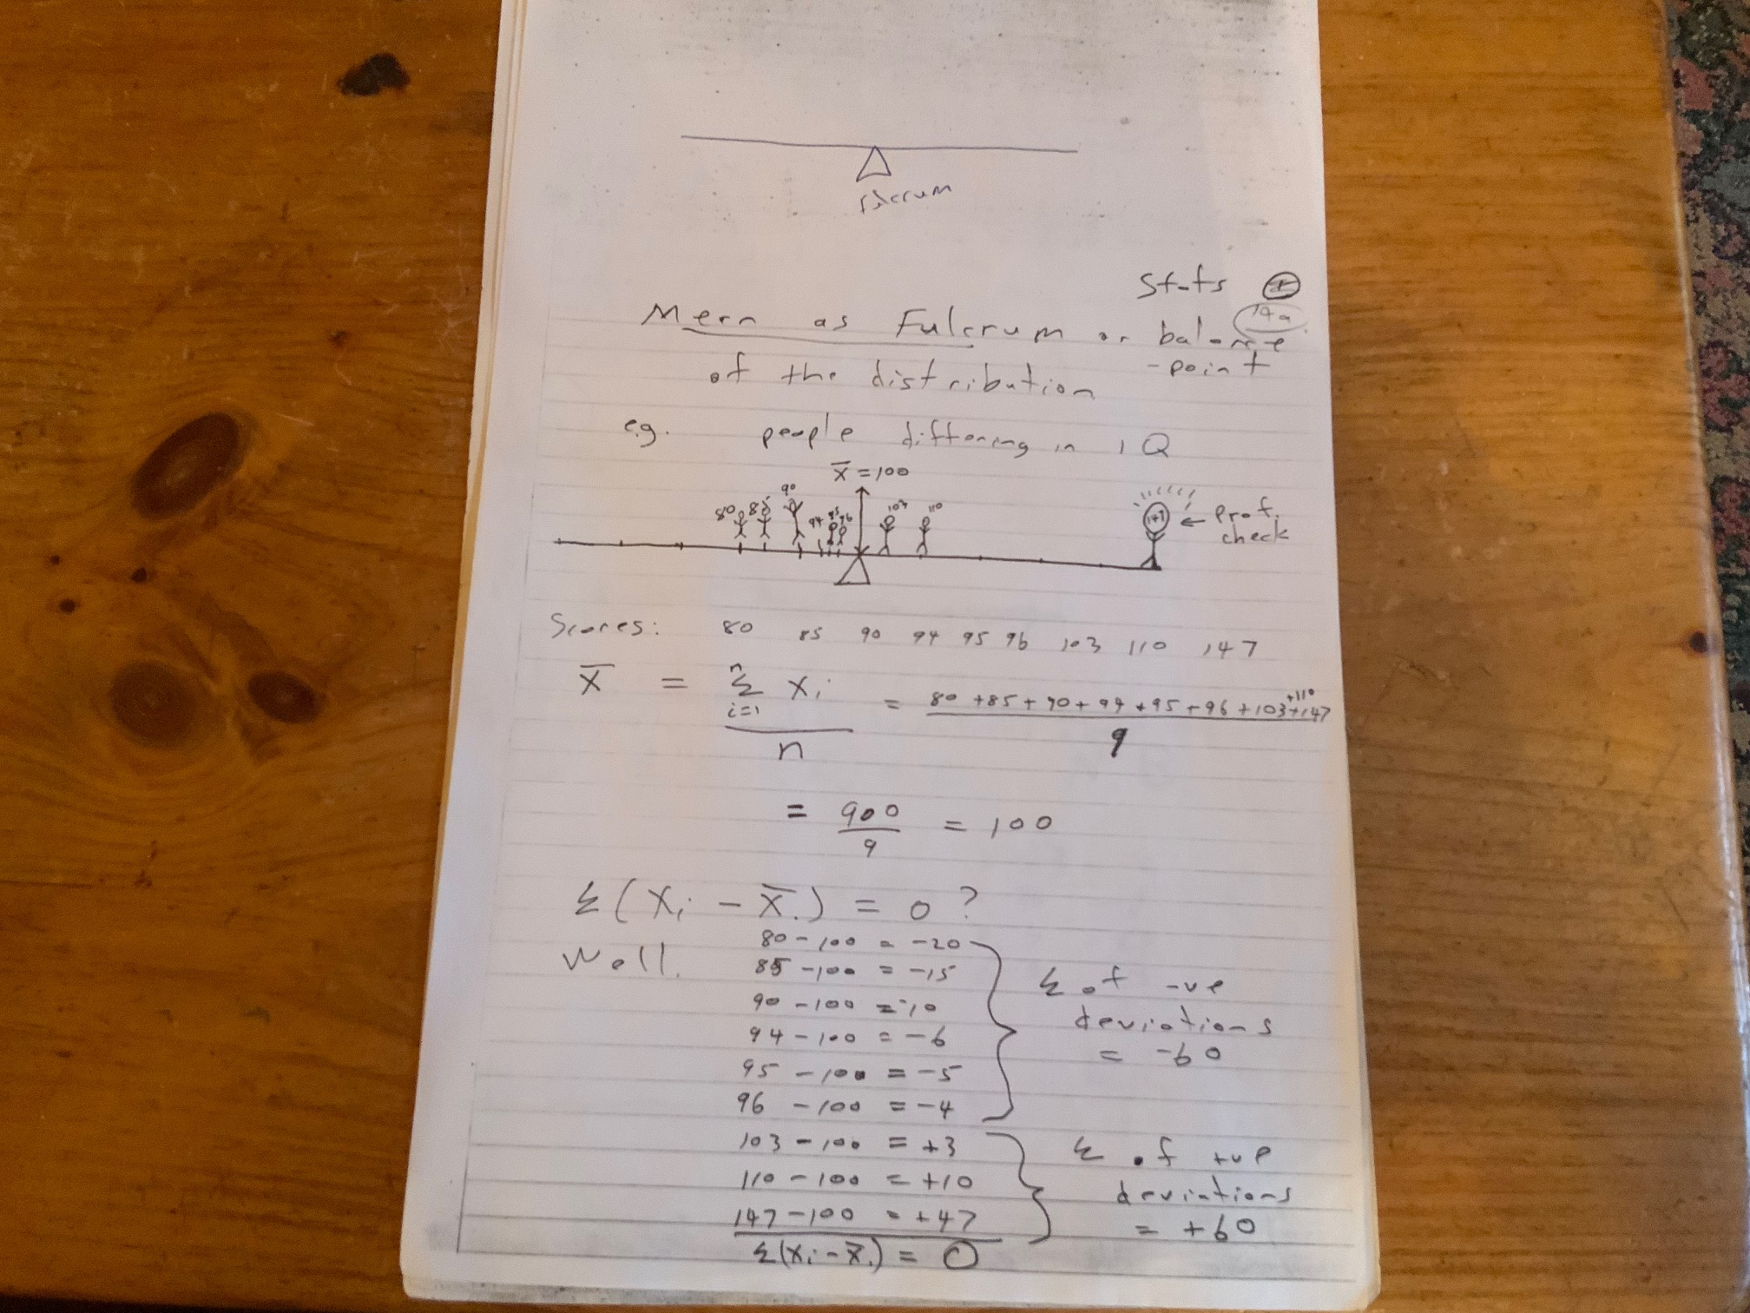

Slide 7
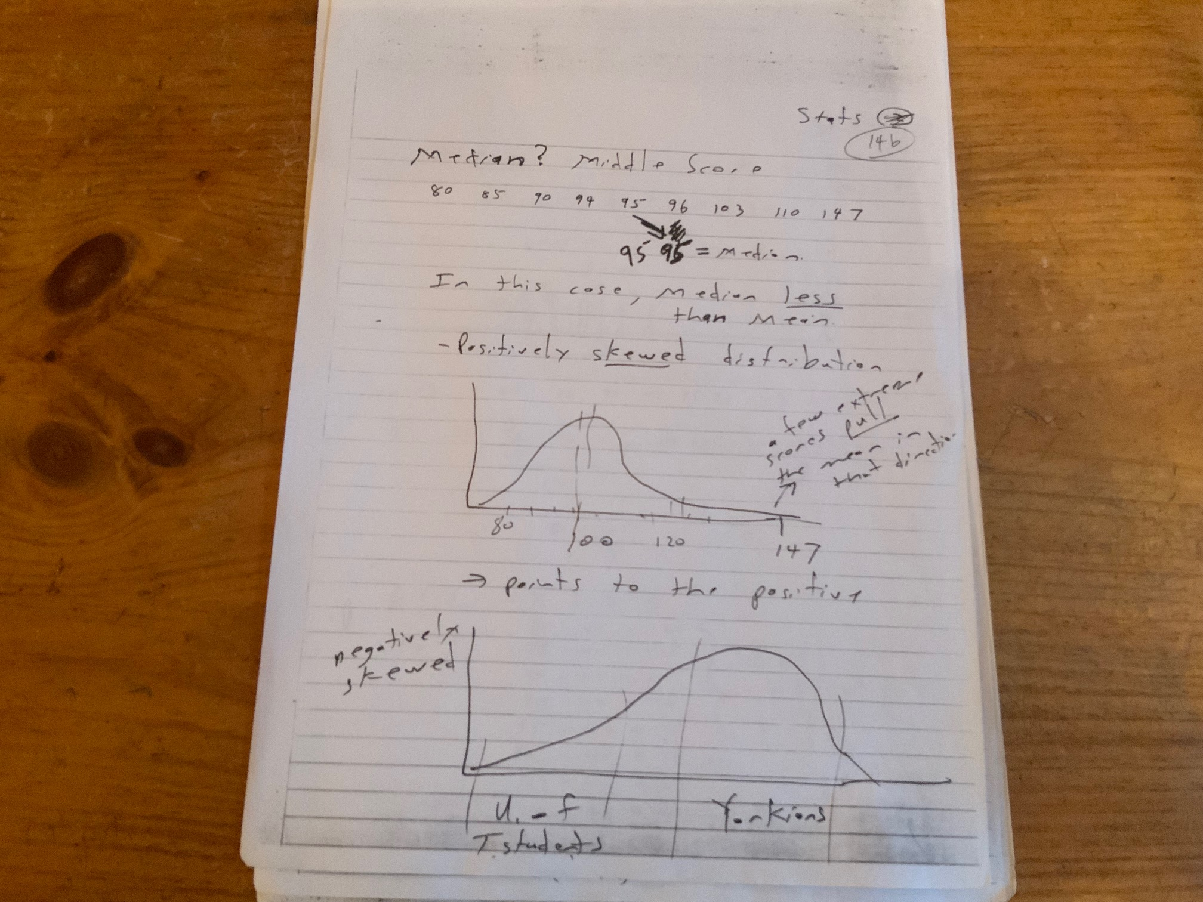
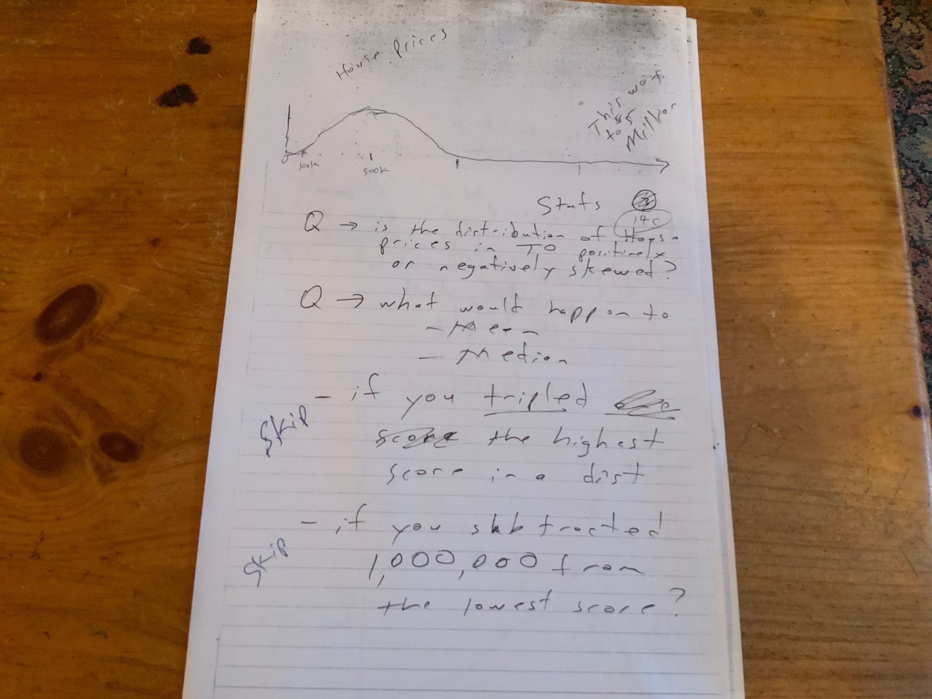

Slide 8
Adding Constants

Slide 9
Multiplying Constants

Slide 10
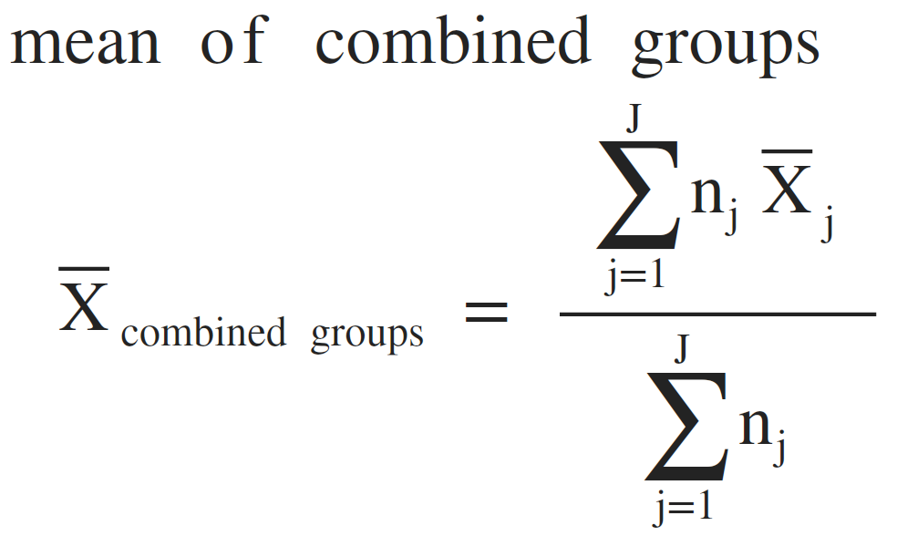
Mean for Combined Groups
The sum of the mean times the number in each group, divided by the sum of the number in each group

Slide 12
Mean of Combined Groups
Mean | n | Total
4 | 4
3 | 5
5 | 3
Notes:
Note that this is not the same as the mean from intervals. From intervals gets you an estimate (assumes even distribution of scores within the interval), whereas this does not and gets you the true mean.

Slide 13
Multiplying Constants

Slide 14
Median
50th percentile
The score that splits the ordered data such that at most half are above and at most half are bellow
2 2 3 4 4 2 2 3 4 4 5

Slide 15
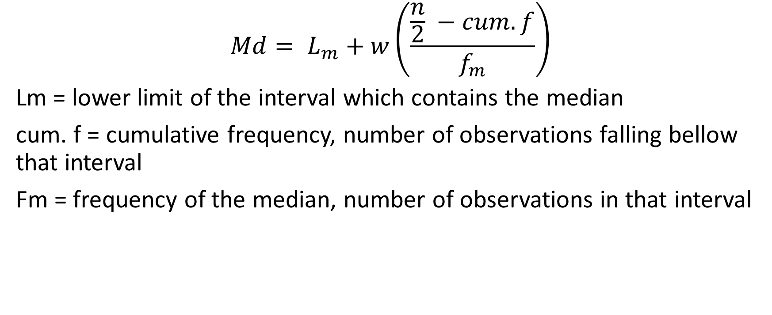
Interpolating Median from Grouped Data
$$Md= L_{m}+w\left(\frac{\frac{n}{2} −cum. f}{f_{m}}\right)$$
Lm = lower limit of the interval which contains the median
cum. f = cumulative frequency, number of observations falling bellow that interval
Fm = frequency of the median, number of observations in that interval
Notes:
Gets you an estimate of the median, as it assumes an even distribution of the scores within the interval

Slide 16
Interpolating the Precise Median
We can use the median from groups formula to get an estimate of the precise median for continuous data
1 1 2 2 2 3
=
x f
1 2
2 3
3 1
1 1 2 2 2 3 = x f 1 2 2 3 3 1

Slide 17
Frequency Distribution
x | Frequency (f)
1-2 | 2
3-4 | 5
5-6 | 3
7-8 | 4
9-10 | 2
Grouped
Frequencies represent a class/interval of scores

Slide 18
The Mode

Slide 19
Mode
The most common score
Grouped and ungrouped is found the same way
Can be used on all types of data
Can have samples with multiple modes
Bimodal, trimodal etc..
Peaks/bumps on the curve

Slide 20
